Slide 1
2024 YR4 – Almost a fireball
Or: The first asteroid which had triggered the official alert system.
Detlef Koschny, TU Munich
Image: ESA/P. Carril

Slide 2
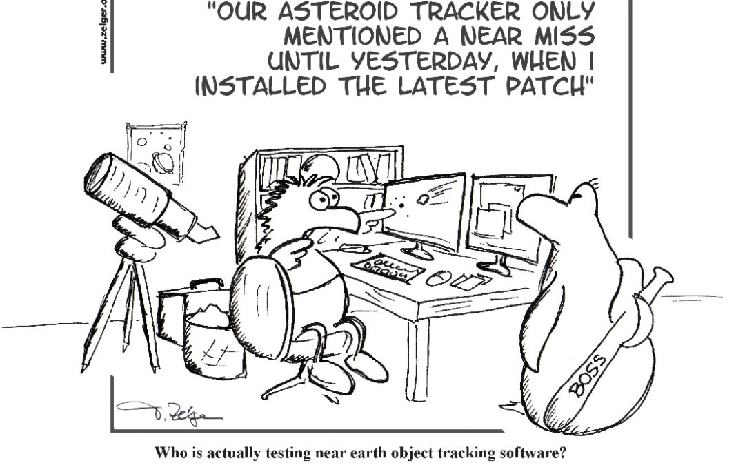
Testing – testing - testing

Slide 3



Slide 4
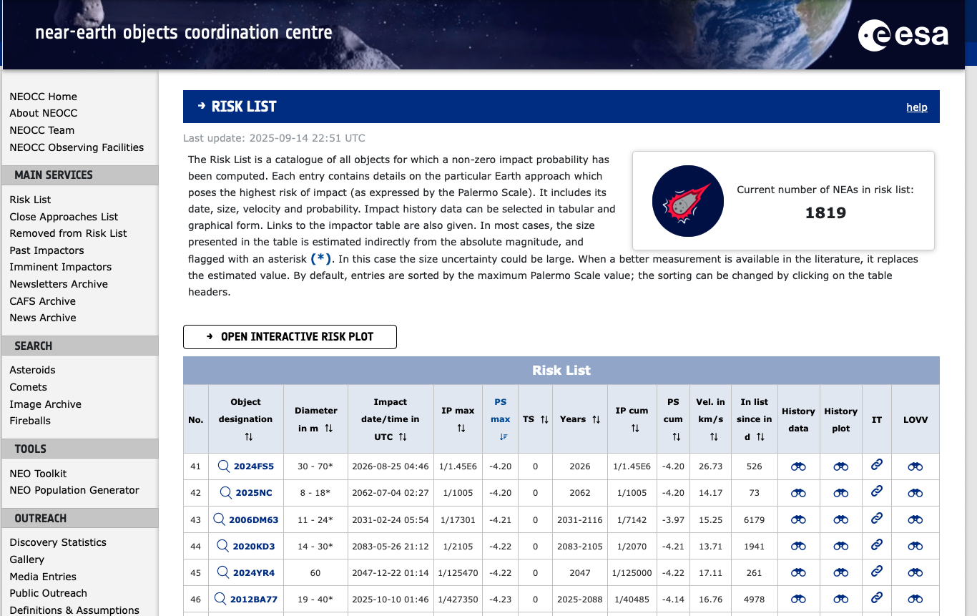
Discovered 27 Dec 2024 – on top of ”risk list"
https://neo.ssa.esa.int/risk-list

Slide 5
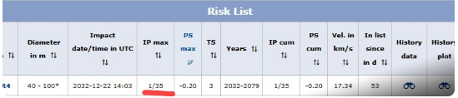
Discovered 27 Dec 2024 – on top of ”risk list"
https://neo.ssa.esa.int/risk-list

Slide 6
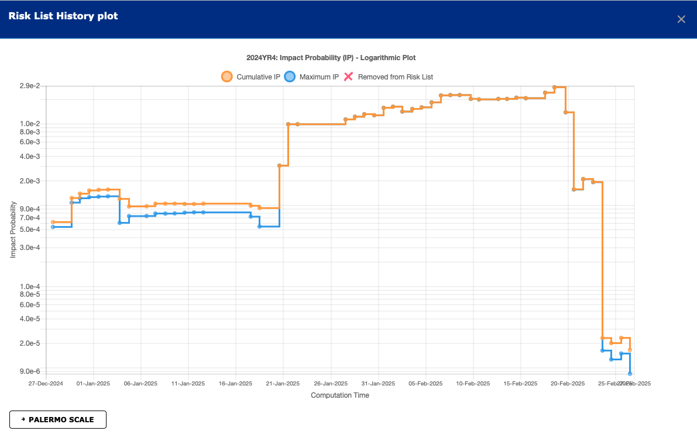
Evolution of the impact probability over time

Slide 7
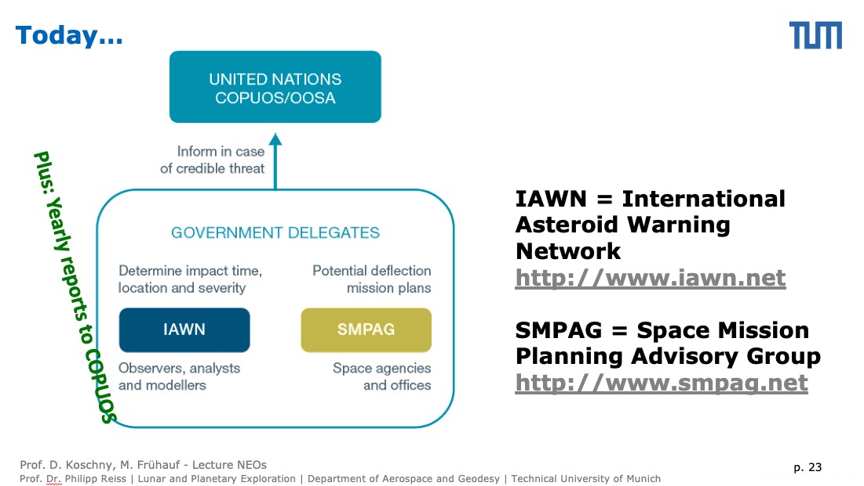
The official alert system as decided by the UN
IP = impact probability
D = size
T = time to impact
IP > 1 %
IP > 1 %
D > 50 m
T < 50 yrs

Slide 8
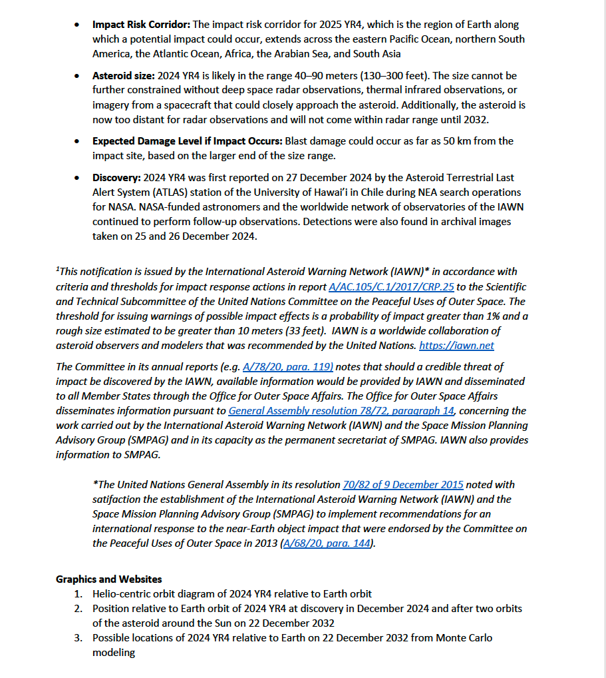
Impact probability >1 %: ‘Notification’
See: iawn.net

Slide 9
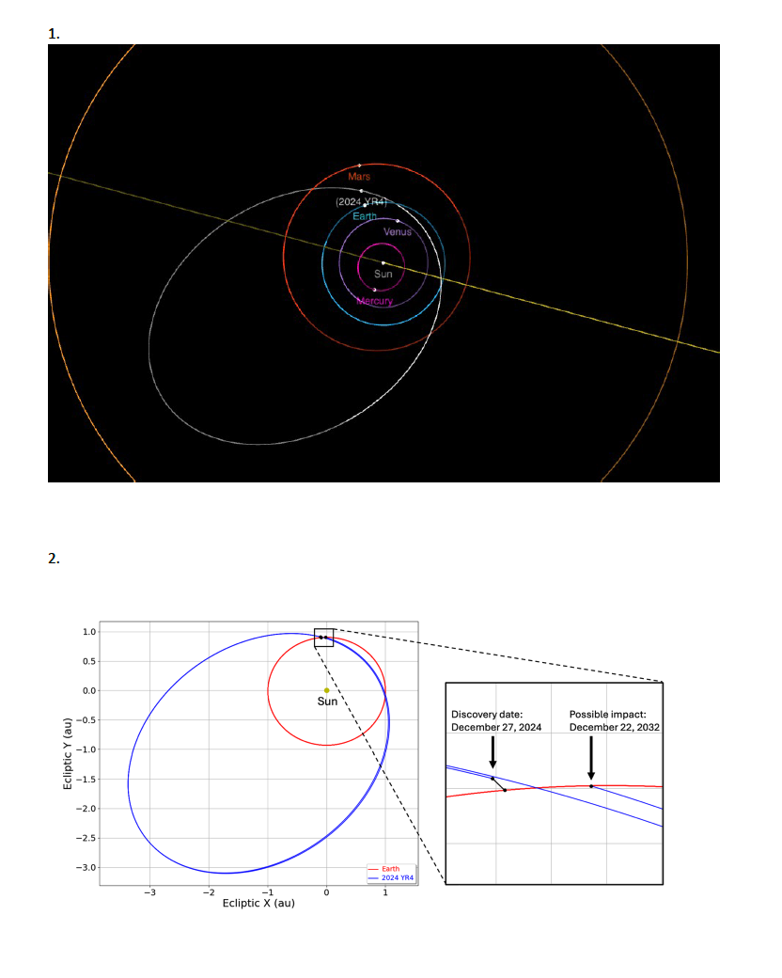
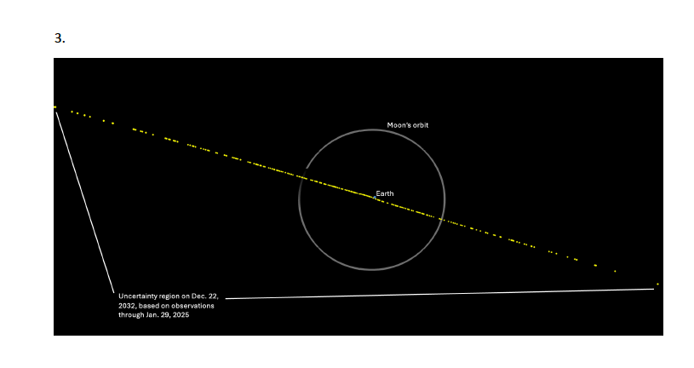
Impact probability >1 %: ‘Notification’

Slide 10
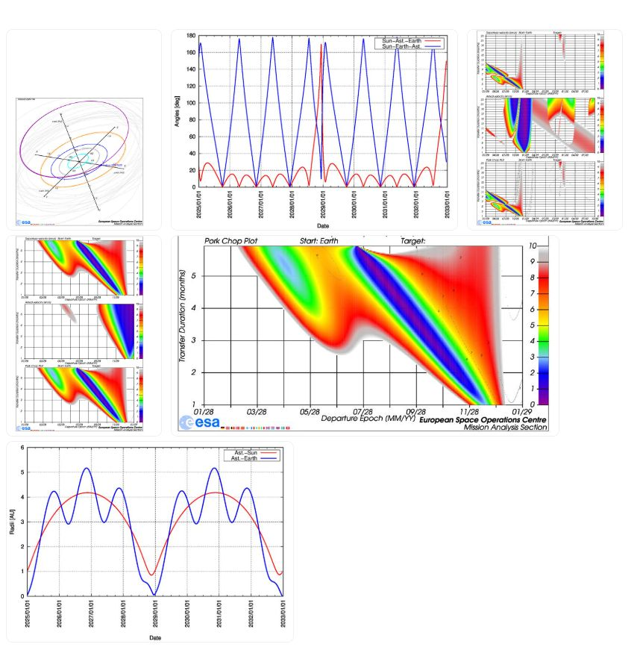
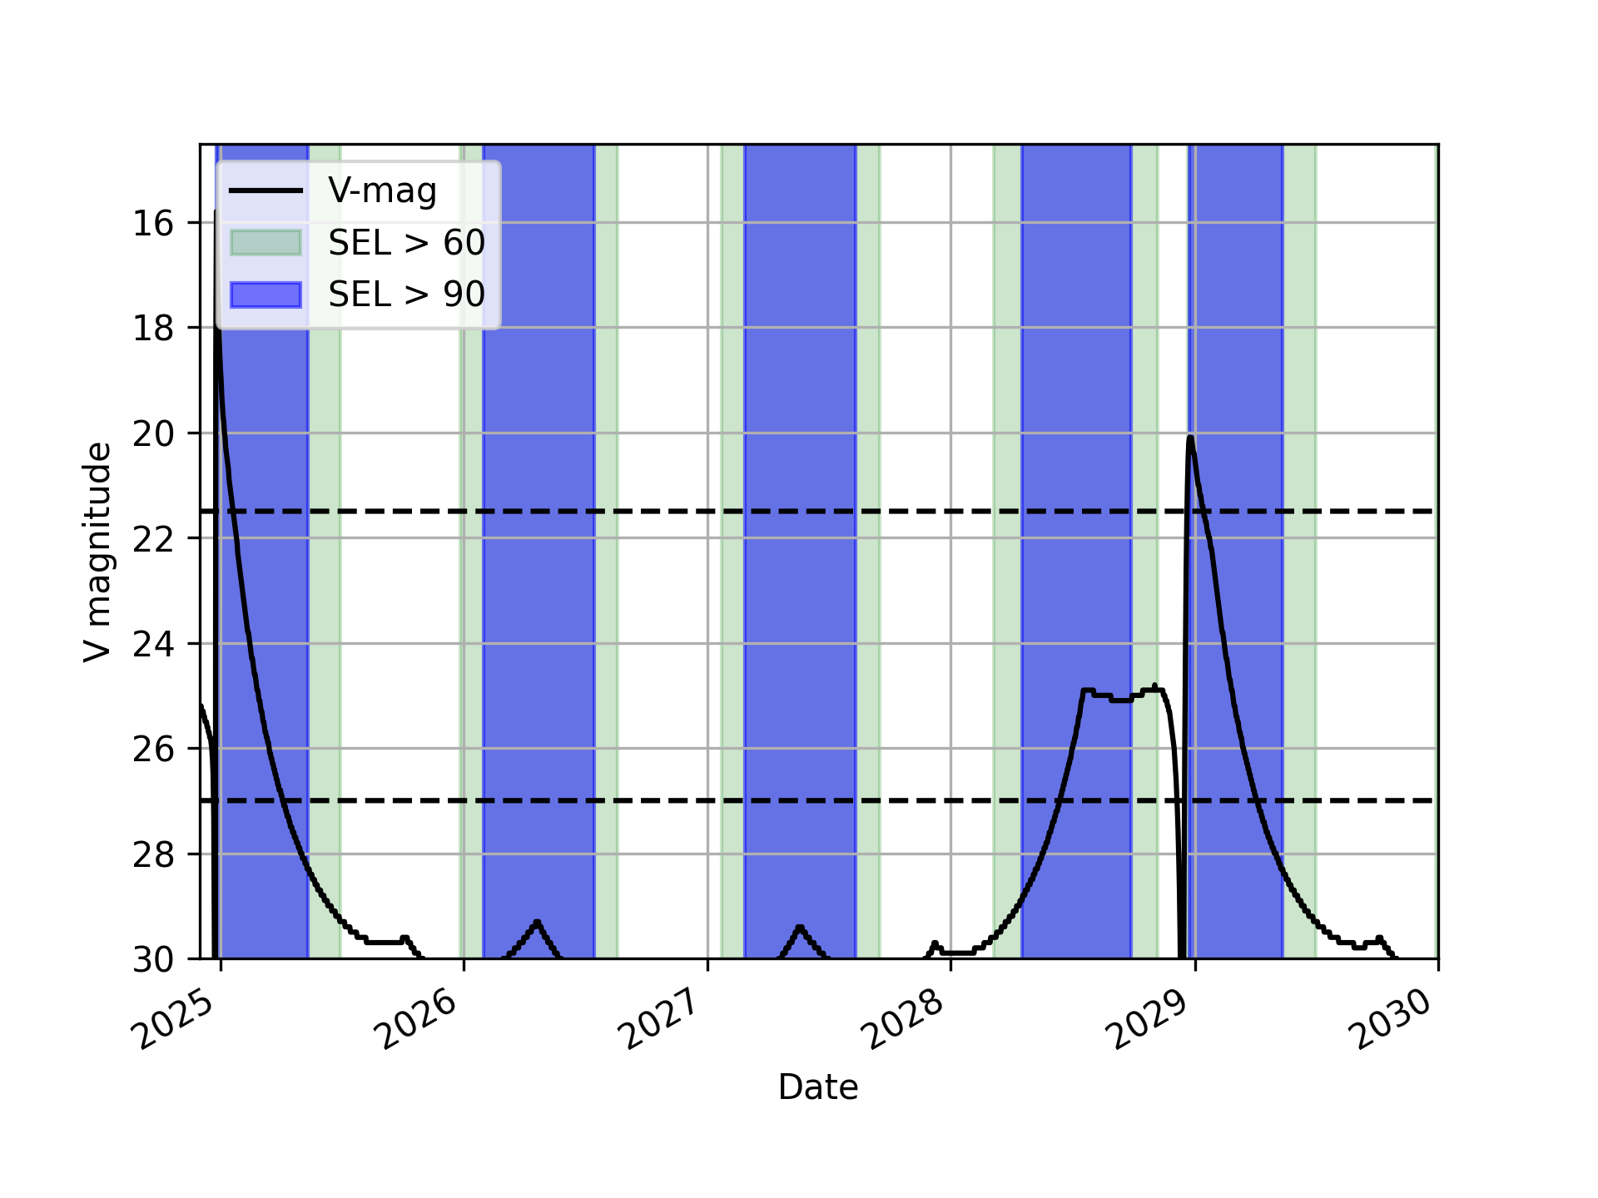
Telecons…
Videcons…

Slide 11
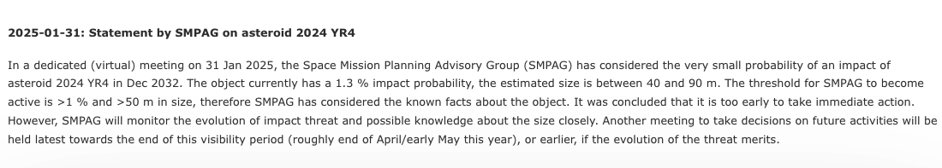

Slide 12
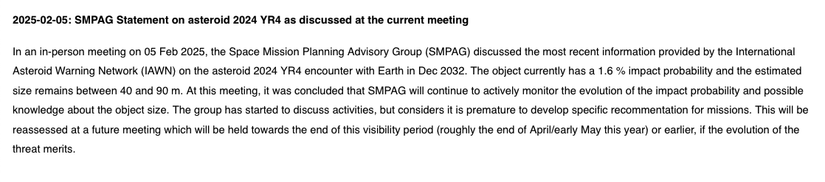

Slide 13
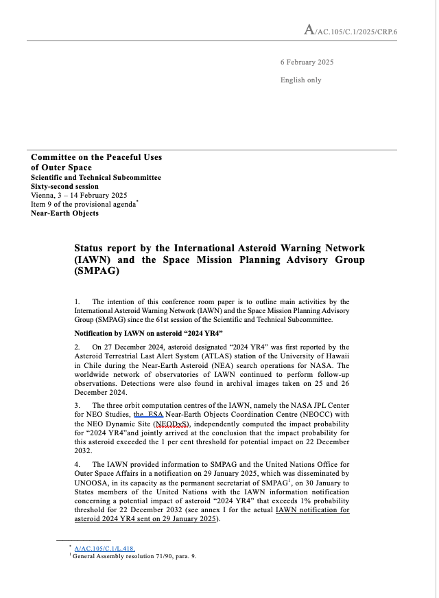
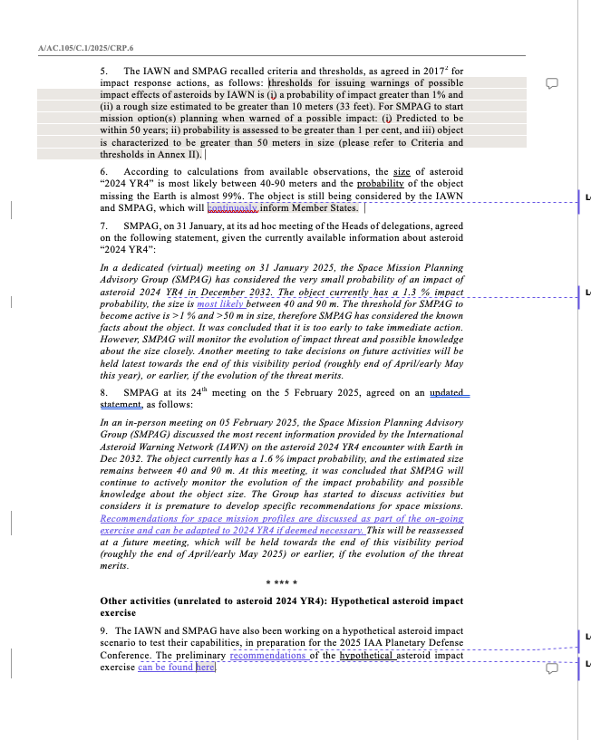
https://www.unoosa.org/oosa/en/oosadoc/data/documents/2025/aac.105c.12025crp/aac.105c.12025crp.6_0.html

Slide 14
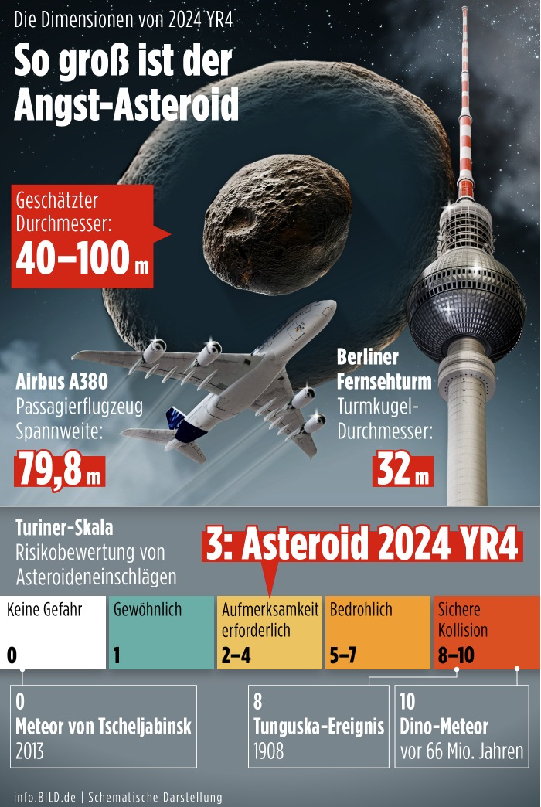
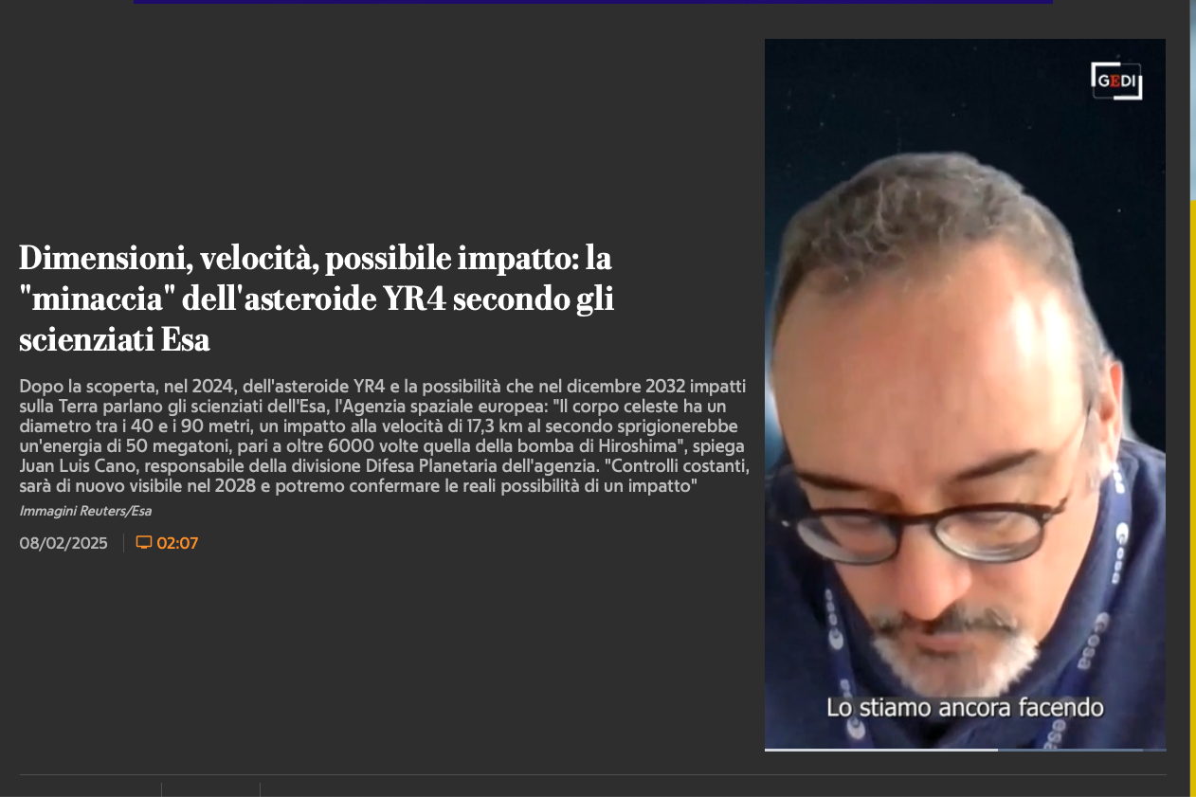
https://www.repubblica.it/esteri/2025/02/08/video/dimensioni_velocita_possibile_impatto_la_minaccia_dellasteroide_yr4_secondo_gli_scienziati_esa-423988642/
Quelle: info.bild.de

Slide 15
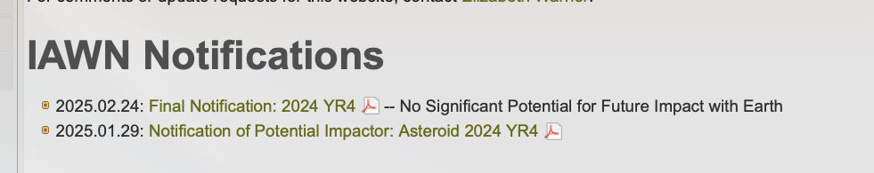
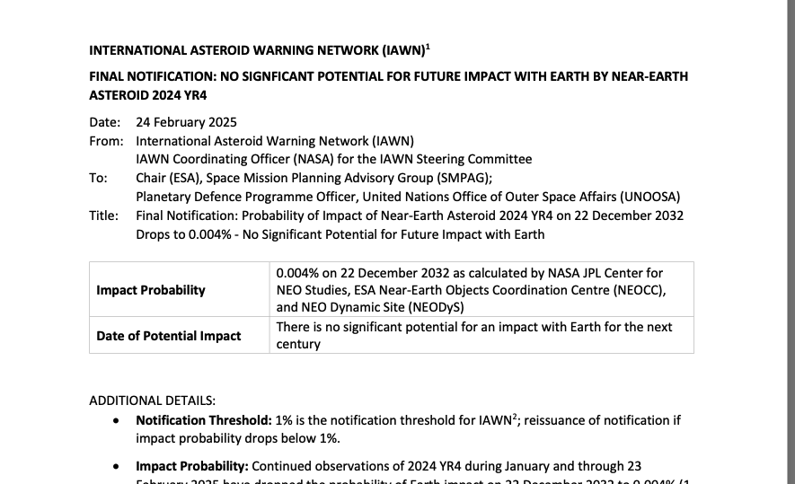
https://iawn.net

Slide 16
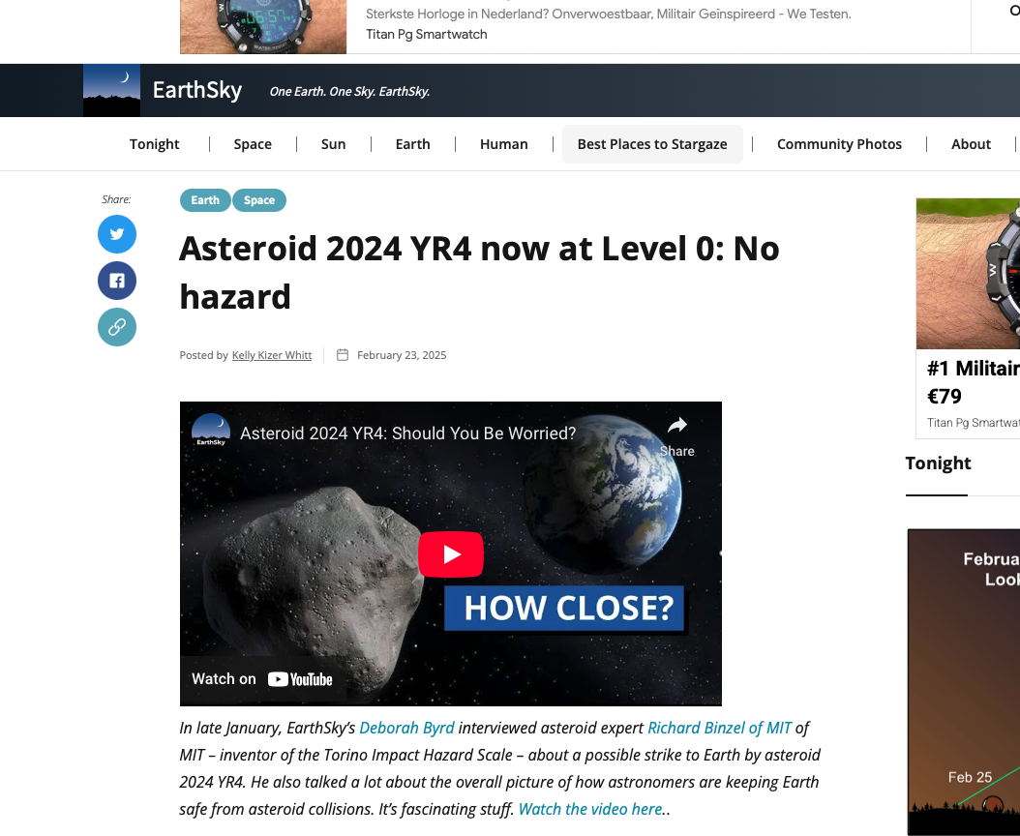

Slide 17
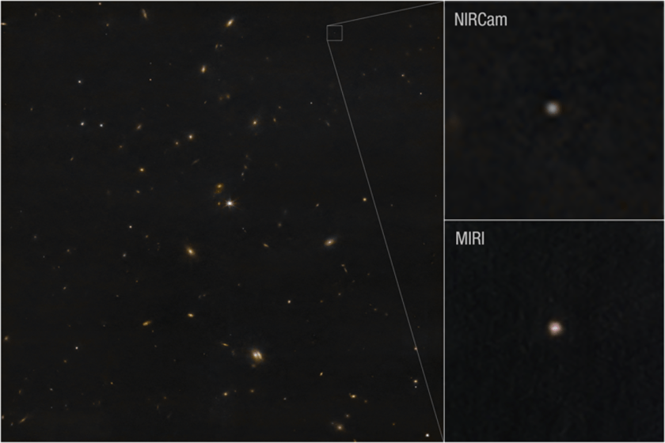
Credit: NASA, ESA, CSA, STScI, A. Rivkin (JHU APL)

Slide 18
Credit: NASA, ESA, CSA, STScI, A. Rivkin (JHU APL)
=> ca. 50 to 70 m in size

Slide 19
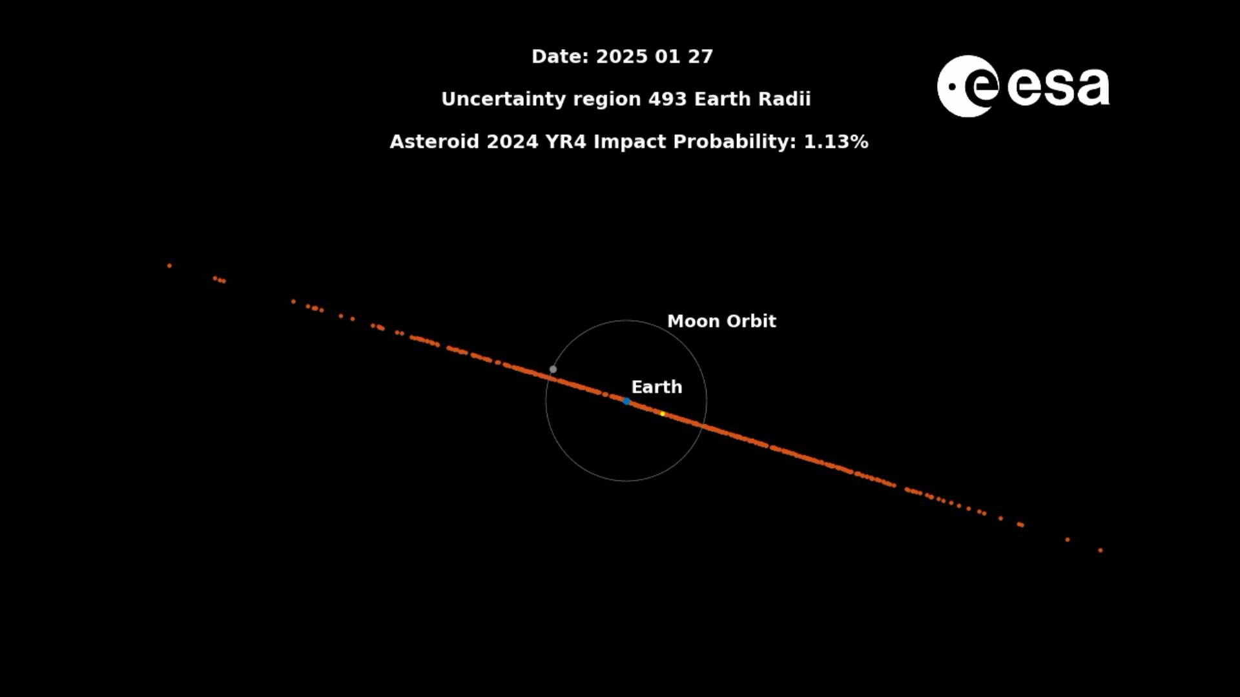
2024 YR4

Slide 20
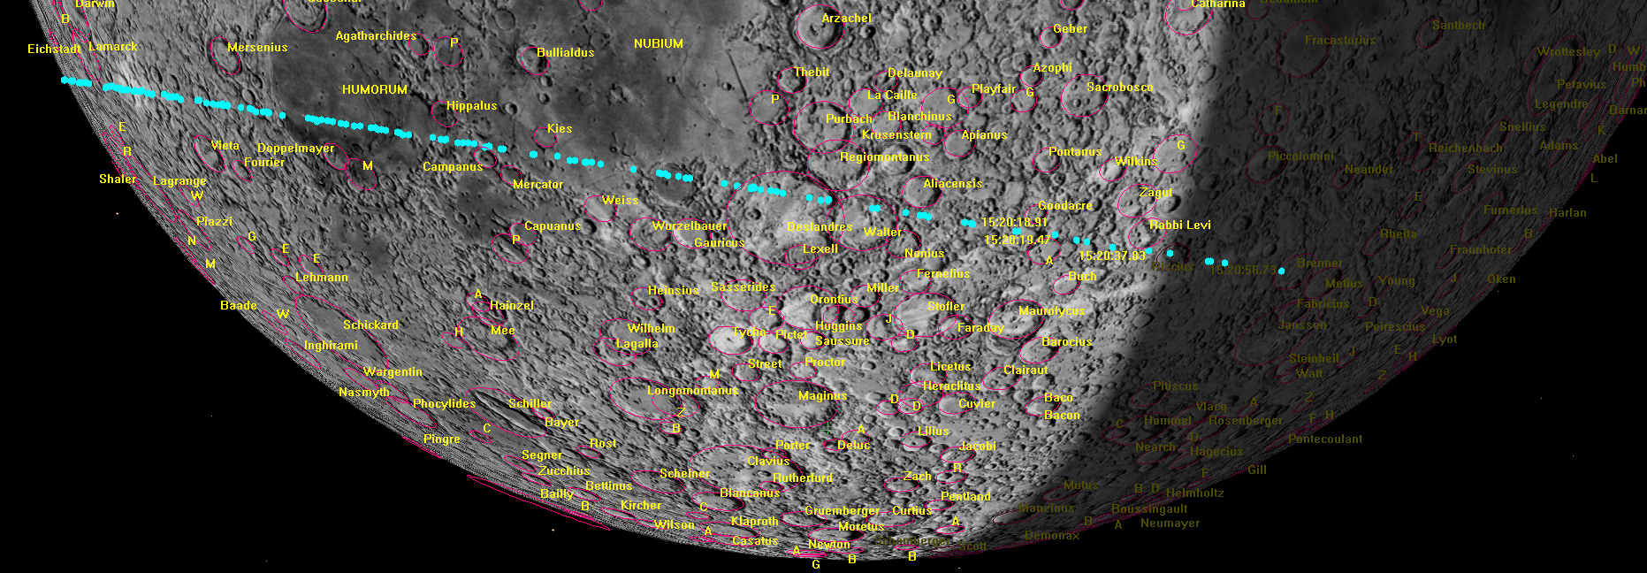
Current situation (as of May 2025): >3 % probability on the Moon
Computation by Bill Gray: https://www.projectpluto.com/temp/yr4/moon.png

Slide 21
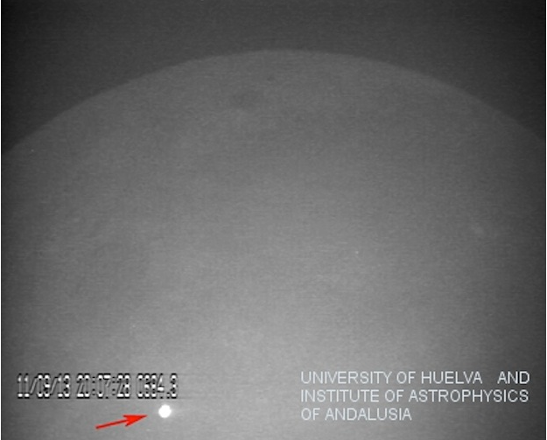

Slide 22
More in 2028….

Slide 23
Additional information

Slide 24
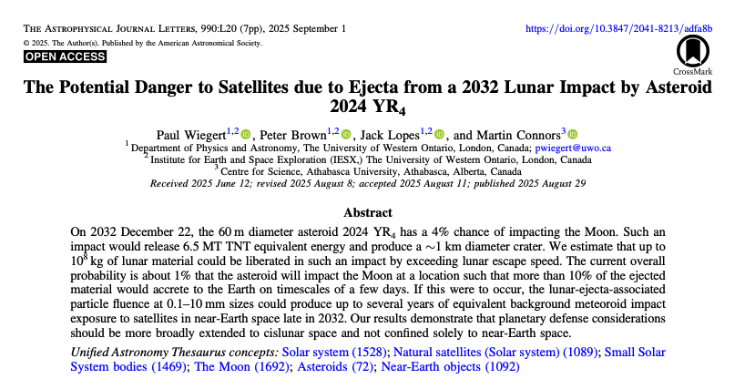
https://iopscience.iop.org/article/10.3847/2041-8213/adfa8b/pdf

Slide 25
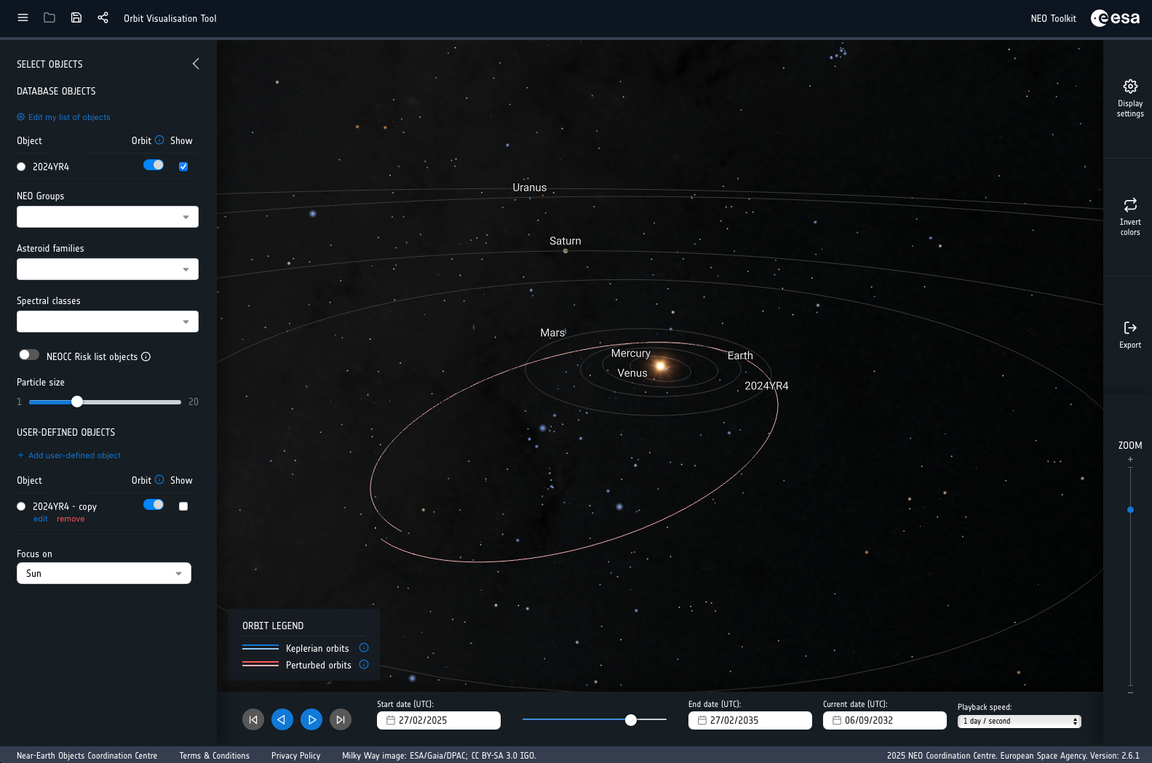
https://neotools.neo.s2p.esa.int/ovt

